Slide 1
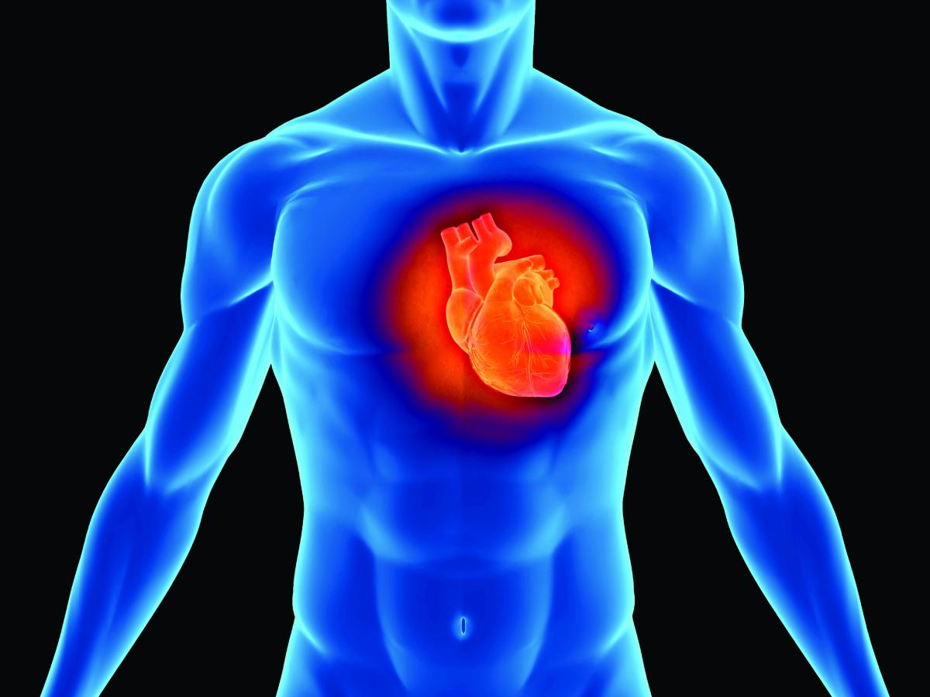
Cardiovascular System – The Heart

Slide 2
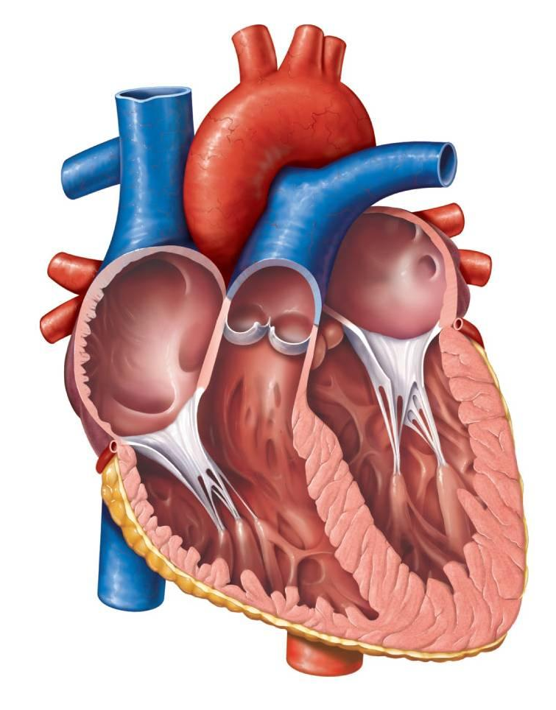
Structure of the Heart
Size and Location
Coverings
Wall of the heart
Chambers and Valves
Path of Blood
Blood Supply
Your heart pumps 7,000 L of blood every day!
It will contract 2.5 billion times in your lifetime.

Slide 3
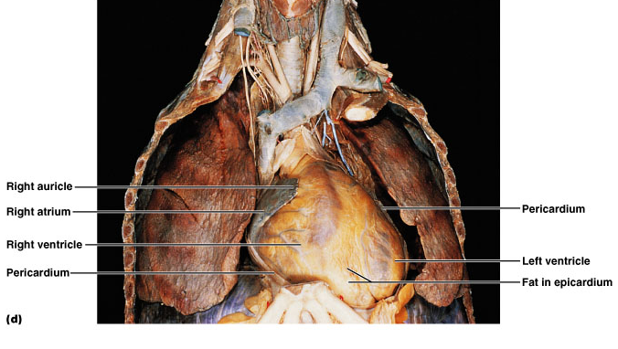
Size and Location
14 cm long x 9 cm wide
In the mediastinum

Slide 4
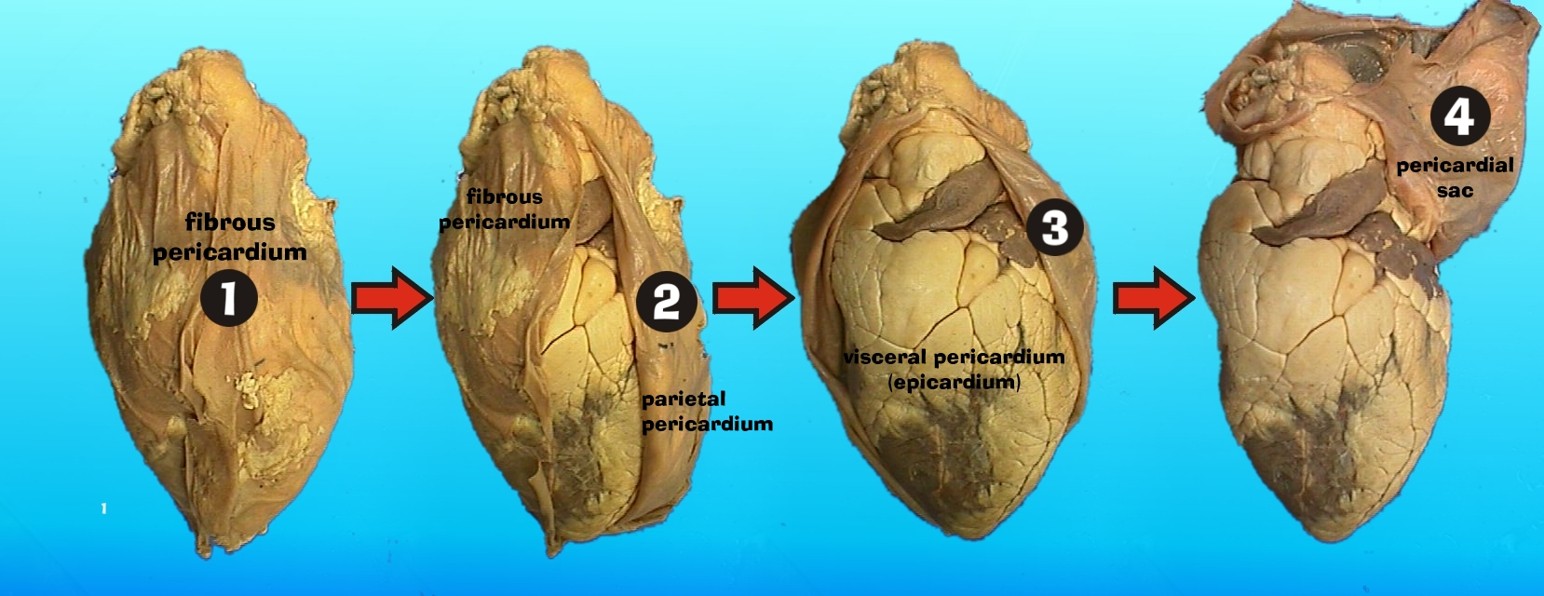
Coverings of the Heart
Pericardium = pericardial sac

Slide 5
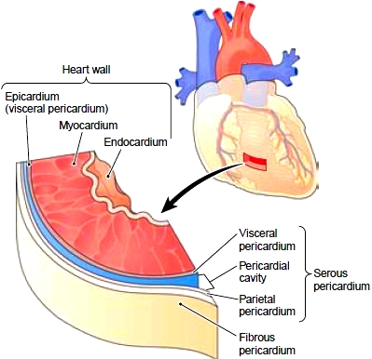
Wall of the Heart

Slide 6
Relative thickness of walls
Atria relatively thin walls because ventricular filling is done by gravity, requiring little effort by atria.
Why is the left side thicker???

Slide 7
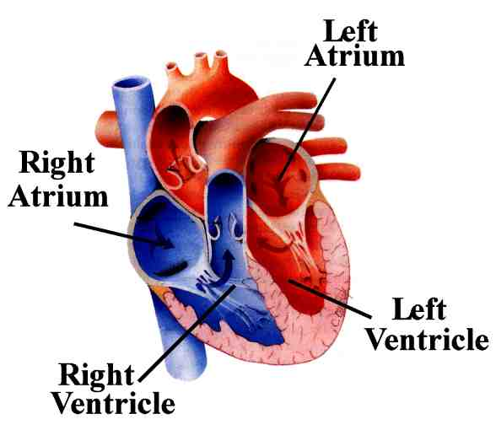
Heart Chambers
Thicker wall – pumps systemically

Slide 8
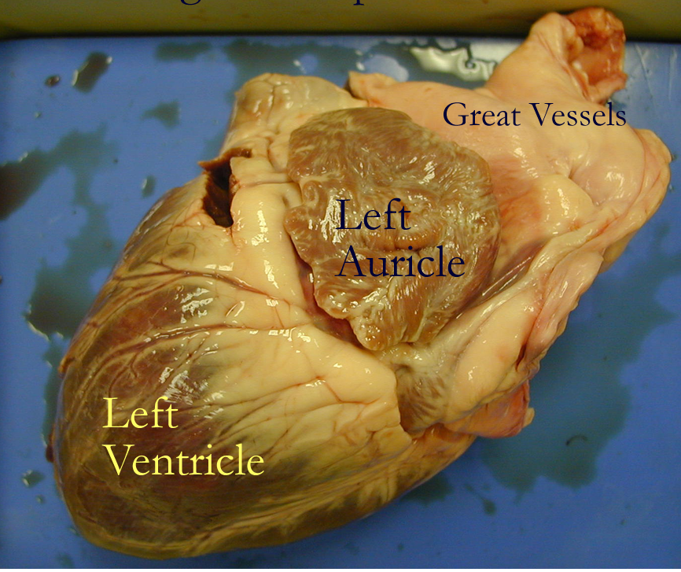
Ear-like flaps to increase volume

Slide 9
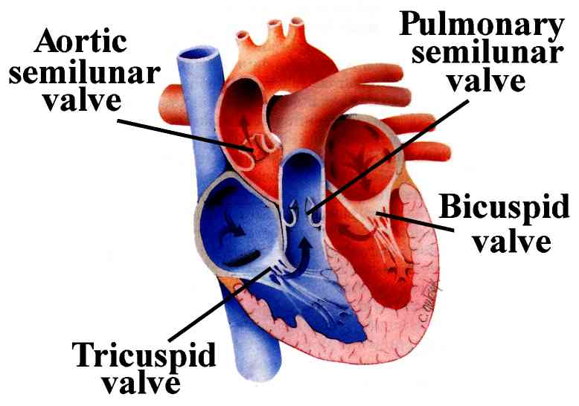
Valves
(Mitral)
Notes:
direction of blood flow: http://www.smm.org/heart/heart/pumping.htm

Slide 10
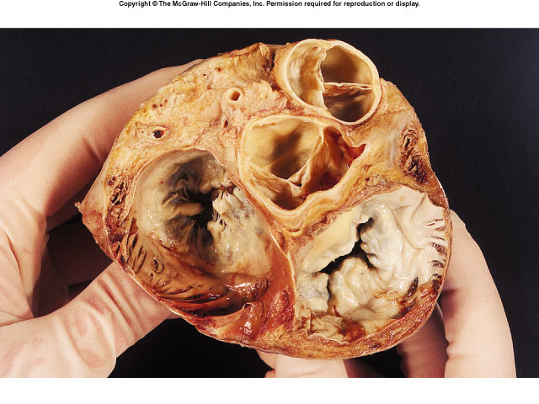
How does blood flow through the heart: http://www.heartpoint.com/theheart.html

Slide 11
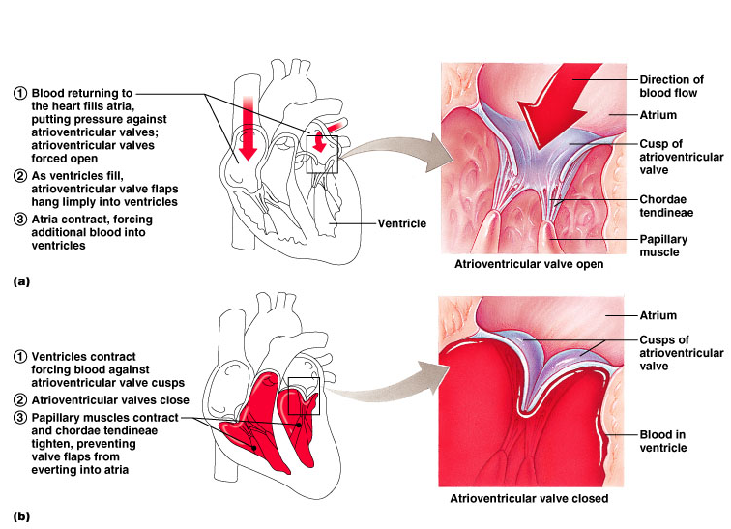
Function of the AV valves

Slide 12
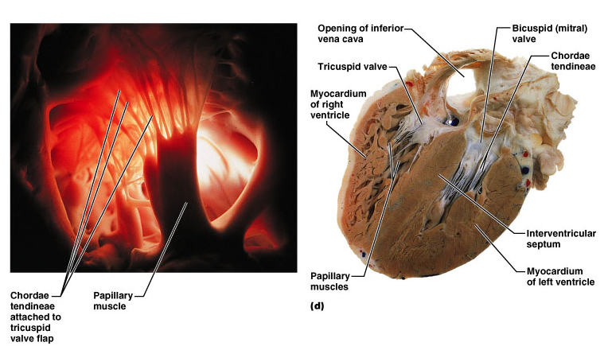

Slide 13
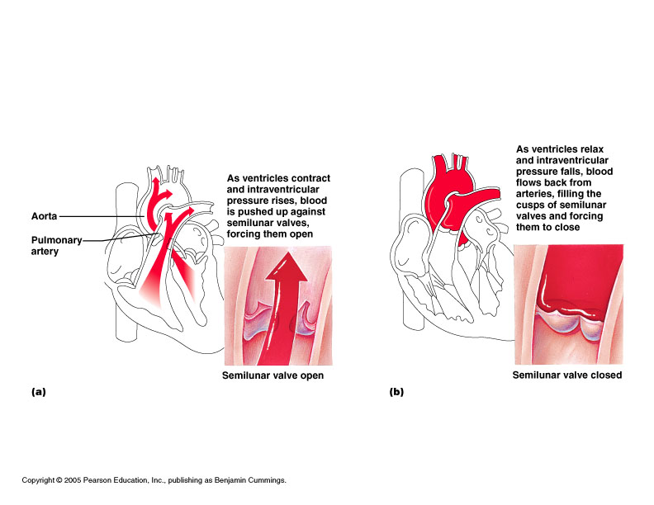
Function of semilunar valves (aortic and pulmonary valves)

Slide 14
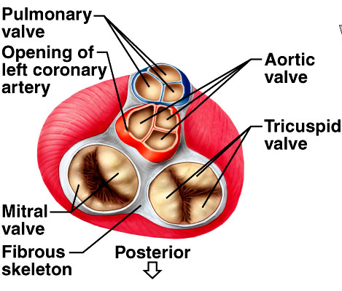
“Skeleton” of Heart – fibrous rings to which the valves are attached

Slide 15
Cardiac Cycle
https://www.youtube.com/watch?v=5tUWOF6wEnk

Slide 16
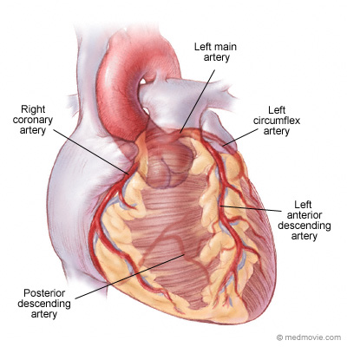
Blood Supply to the Heart

Slide 17
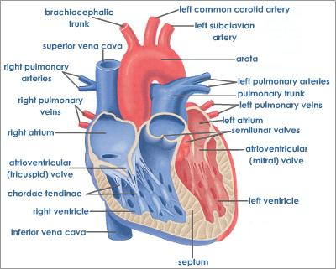
aorta

Slide 18
Blood Flow - simplified

Slide 19
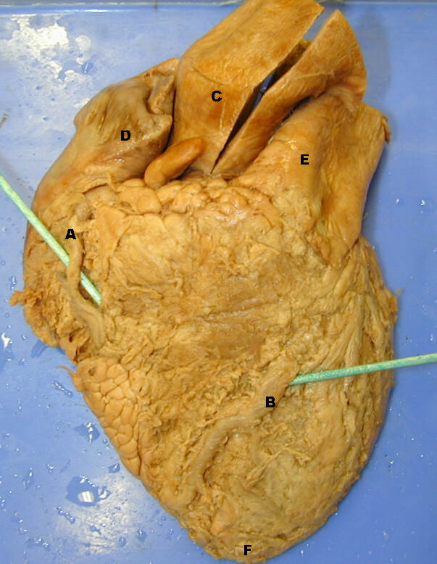
http://homepage.smc.edu/wissmann_paul/heartpics/
There are dissections like this with roll over answers

